Slide 1
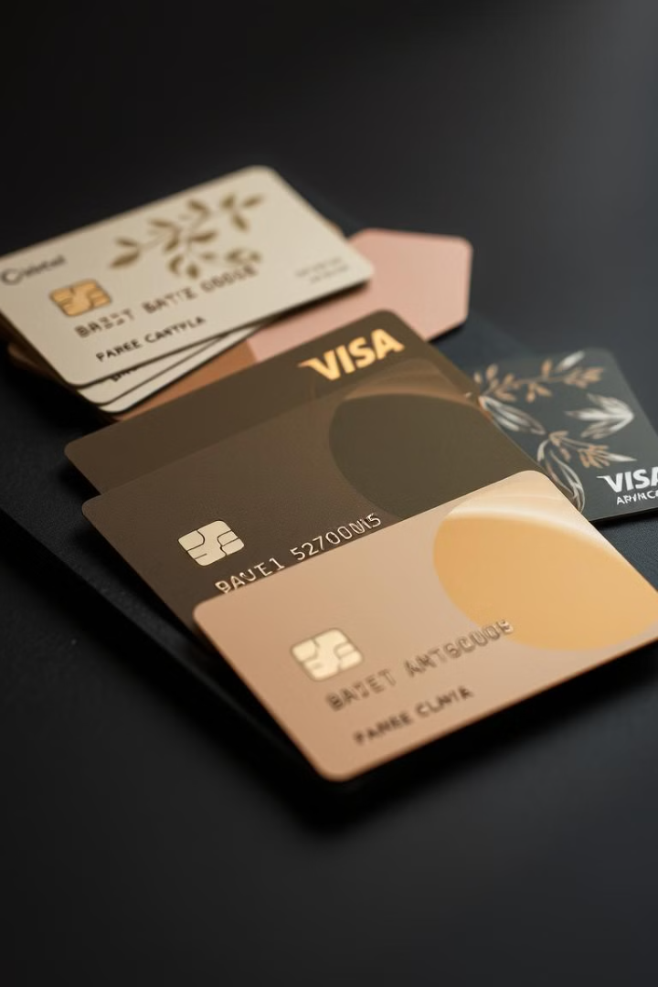

Credit Card Transactions Dataset
The Credit Card Transactions Dataset provides a wealth of information about credit card transactions, encompassing transaction times, amounts, and associated personal and merchant details. This dataset, containing over 1.85 million rows, offers valuable insights for various analytical purposes.
by Hager Mahmoud

Slide 2
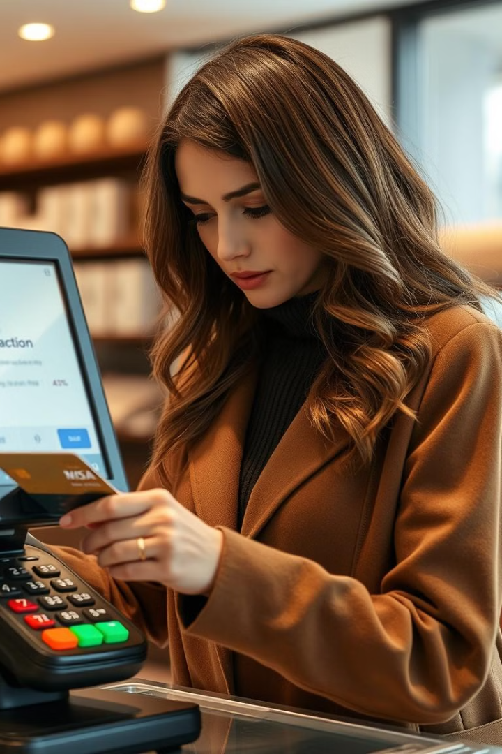
Fraud Detection
1
Transaction Amount Analysis
Analyze transaction amounts, identifying outliers and unusual spending patterns that may indicate fraudulent activity.
2
Location Tracking
Track transaction locations and identify unusual geographical patterns, such as multiple transactions in a short time period at different locations.
3
User Profile Analysis
Examine user profiles, comparing transaction behaviors with known patterns to detect discrepancies that might signal fraud.
4
Machine Learning Models
Employ machine learning models trained on historical data to identify fraudulent transactions based on complex patterns and relationships.

Slide 3
Customer Segmentation
Spending Patterns
Location
Demographics
Segment customers based on their spending habits, such as high-value spenders, budget-conscious shoppers, or frequent buyers.
Group customers based on their geographic location to tailor marketing campaigns and offers to specific regions.
Segment customers by demographic factors, such as age, gender, and income level, to personalize marketing messages and product recommendations.

Slide 4

Transaction Classification
Category
Description
Grocery
Transactions at supermarkets and grocery stores.
Dining
Transactions at restaurants, cafes, and food delivery services.
Travel
Transactions related to flights, hotels, and travel agencies.
Entertainment
Transactions at movie theaters, concerts, and amusement parks.

Slide 5
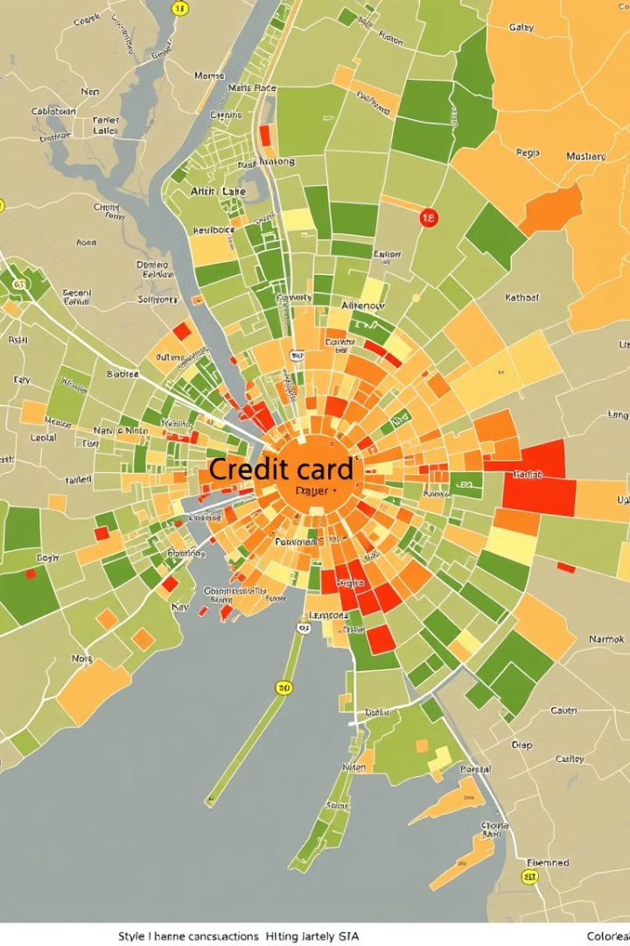



Geospatial Analysis
Location Data
Extract latitude and longitude coordinates from transaction data to visualize spending patterns on a map.
Spatial Clustering
Identify clusters of high transaction density, revealing areas with significant spending activity.
Regional Trends
Analyze spatial patterns to detect regional trends and anomalies in consumer spending habits.

Slide 6
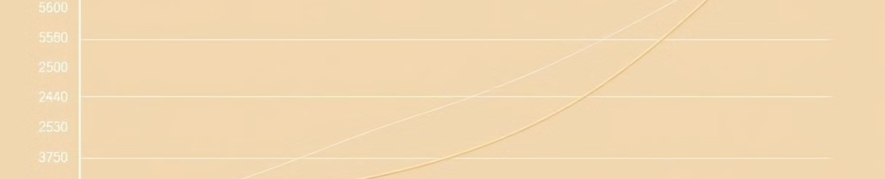
Predictive Modeling
Spending Forecasting
Fraud Risk Assessment
Financial Trend Analysis
Predict future spending behavior based on historical transaction data, including seasonal variations and customer trends.
Develop models to identify potential fraudulent transactions by predicting the likelihood of suspicious activity based on transaction history.
Forecast financial trends based on transaction data to gain insights into market dynamics and consumer spending patterns.

Slide 7
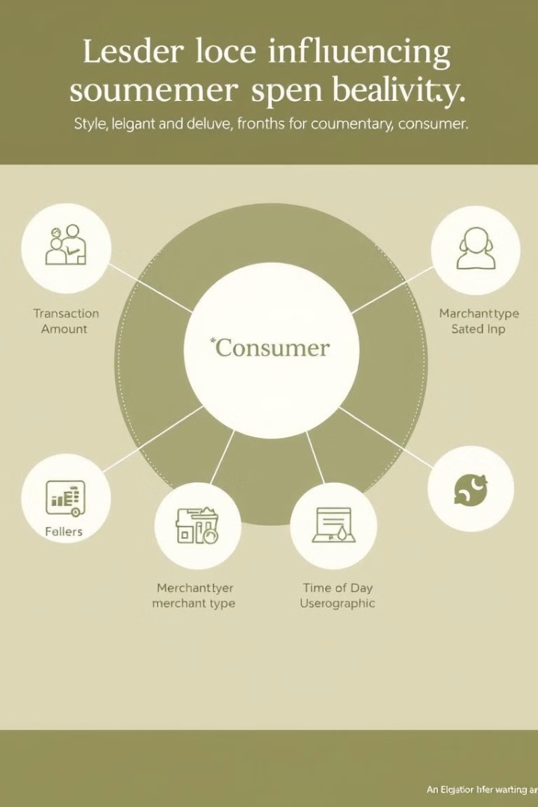
Behavioral Analysis
1
Transaction Amount
Analyze the impact of transaction amount on spending behavior, identifying relationships between spending levels and purchase frequency.
2
Merchant Type
Study the influence of merchant type on spending patterns, revealing preferences for specific categories of goods and services.
3
Time of Day
Examine how time of day affects spending patterns, identifying peak periods for different types of transactions.
4
User Demographics
Investigate the relationship between user demographics, such as age, income, and location, and spending habits.

Slide 8
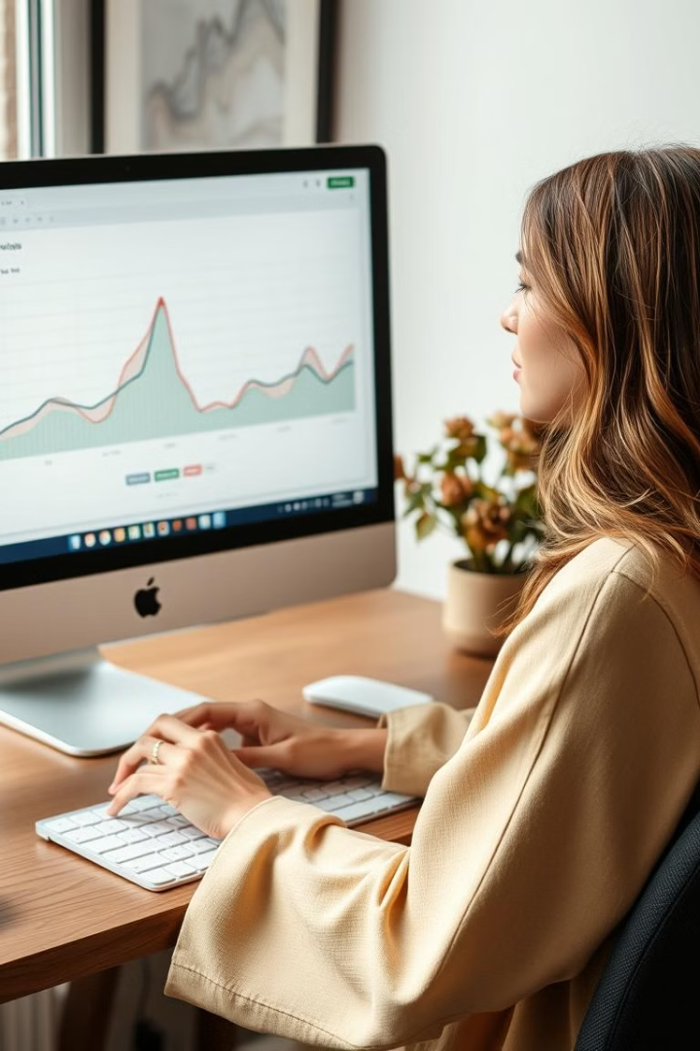



Anomaly Detection
Unusual Transaction Patterns
Identify transactions that deviate significantly from typical spending patterns, suggesting potential fraudulent activities.
Suspect Behavior
Detect suspicious behavior, such as multiple transactions in a short period, large purchases at unusual locations, or spending exceeding usual limits.
Early Detection
Employ anomaly detection techniques to flag potential fraud early, allowing for timely intervention and mitigation of financial losses.

